Slide 1
Learning Agent Representations for Ice Hockey
Guiliang Liu (Presenter), Oliver Schulte, Pascal Poupart, Mike Rudd, and Mehrsan Javan.

Slide 2
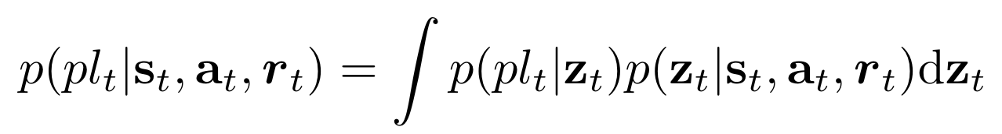

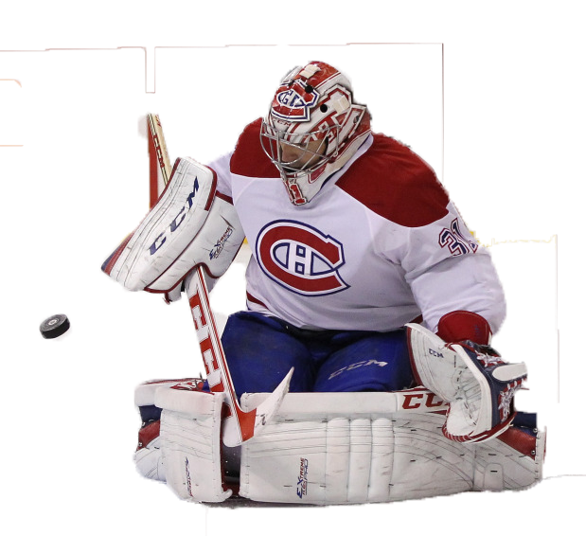
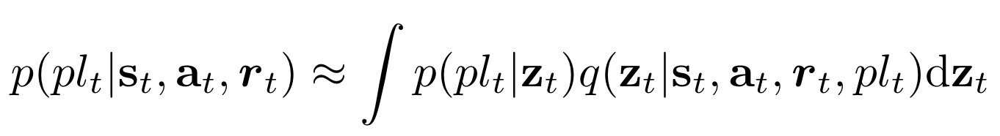
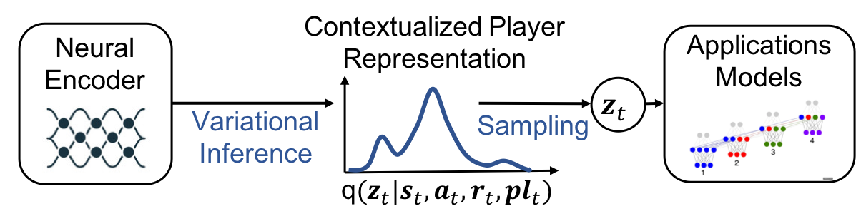
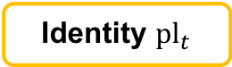
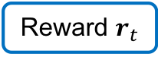
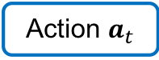
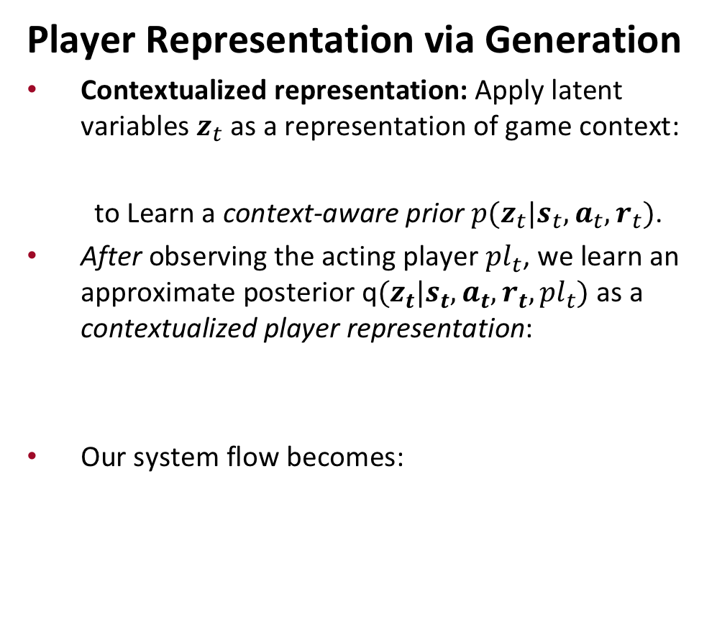
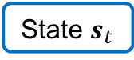
Player Embedding
Embed Player Information
Definition: Modeling the special characteristics of individual players (Learning Agent Representation).
Motivation: e.g., Expected Goal (XG) Prediction.
Challenge: 1) Large agent number (>1k). 2) Sparse and diverse player observation.
Player Representation via Generation
Contextualized representation: Apply latent variables $z_{t}$ as a representation of game context:
to Learn a context-aware prior $p(z_{t}|s_{t},a_{t},r_{t})$.
After observing the acting player ${pl}_{t}$, we learn an approximate posterior q$(z_{t}|s_{t},a_{t},r_{t},{pl}_{t})$ as a contextualized player representation:
Our system flow becomes:
Identity ${pl}_{t}$
Goal ?
State $s_{t}$
Shot
Action $a_{t}$
Reward $r_{t}$
Neurips 2020 Presentation

Slide 3
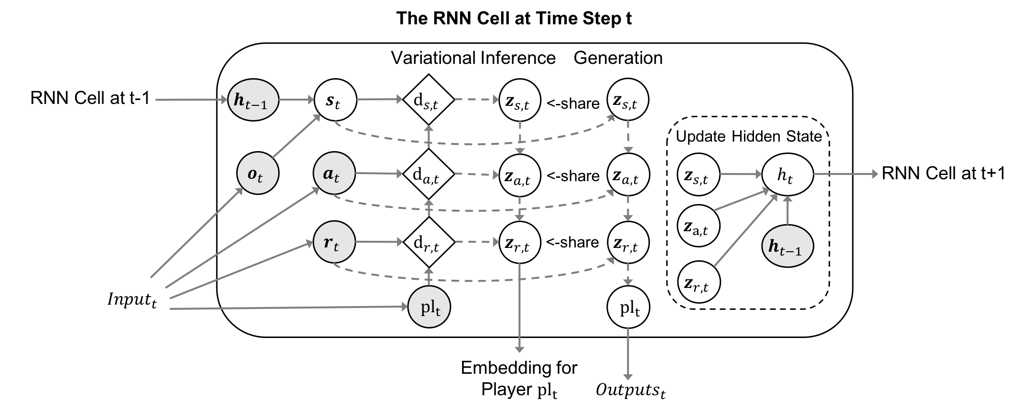
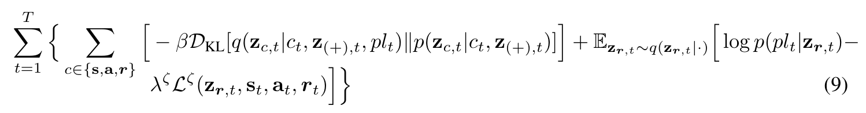
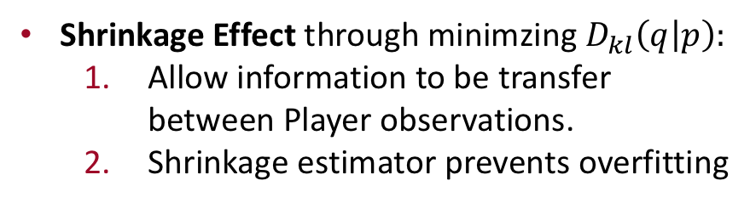
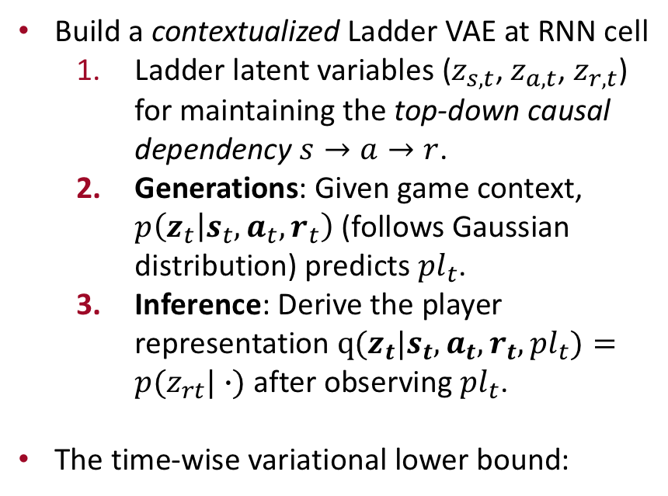
Model Structure
Variational Recurrent Ladder Agent Encoder (VaRLEA)
Build a contextualized Ladder VAE at RNN cell
Ladder latent variables ($z_{s,t}$, $z_{a,t}$, $z_{r,t}$) for maintaining the top-down causal dependency $s→a→r$.
Generations: Given game context, $p\left(z_{t} | s_{t},a_{t},r_{t}\right)$ (follows Gaussian distribution) predicts ${pl}_{t}$.
Inference: Derive the player representation $q(z_{t}|s_{t},a_{t},r_{t},{pl}_{t})=p(z_{rt}|∙)$ after observing ${pl}_{t}$.
The time-wise variational lower bound:
Shrinkage Effect through minimzing $D_{kl}\left(q | p\right):$
Allow information to be transfer between Player observations.
Shrinkage estimator prevents overfitting
Neurips 2020 Presentation
Notes:
Shrinkage Effect:
It allows information to be transferred between the observations of different players and draws closer the representations of players who share statistical similarities.
A shrinkage estimator prevents theencoder from overfitting to players with high participation, allowing our representation to generalizeto the diversity and the sparsity of context-aware player distributions.

Slide 4
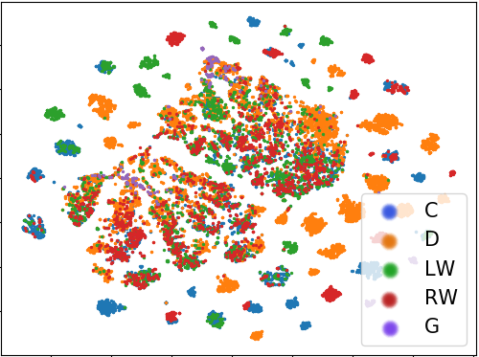
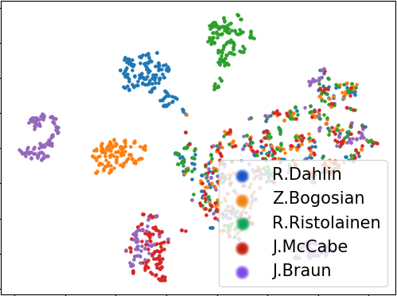
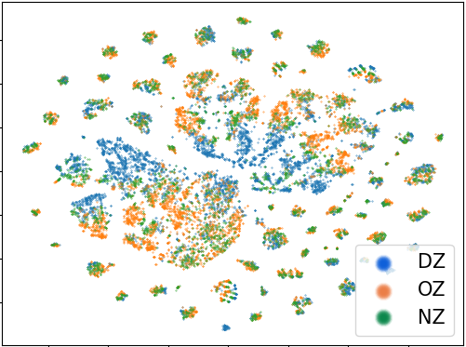
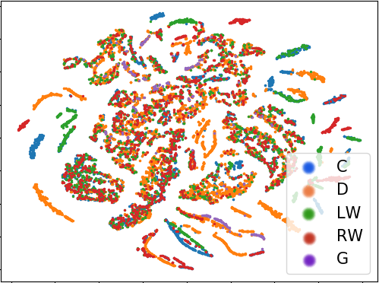
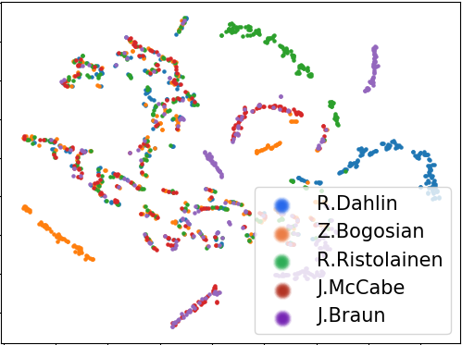
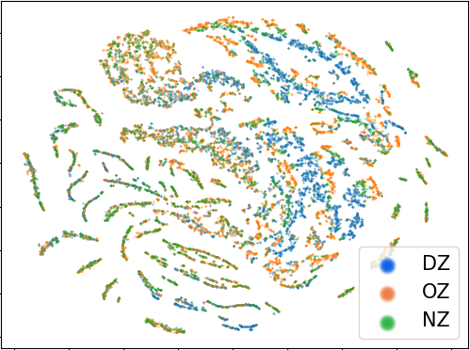
Empirical Evaluation
Embedding Visualization and Case Study:
1) Visualize the generated player embeddings with t-SNE. 2) Compared against a CAERNN (without shrinkage).
Player Position
Player Name
Player Location
VaRLEA
CAERNN
Neurips 2020 Presentation
Notes:
Visualization Method.
Randomly select 5 games from the testing set.
Compute the contextualized embeddings for the acting player at each event.
Visualize the high-dimensional embedding with the unsupervised T-distributed Stochastic Neighbor Embedding (T-SNE)

Slide 5
Conclusion
The take-home message:
Shrinkage estimator can handle large dataset with
Diversity (many different agents).
Sparsity (each agents with limited observations).
Modeling player information with player representation can improve the performance of downstream applications.
Neurips 2020 Presentation
Notes:
Thank you for your time and interest today!

Slide 6
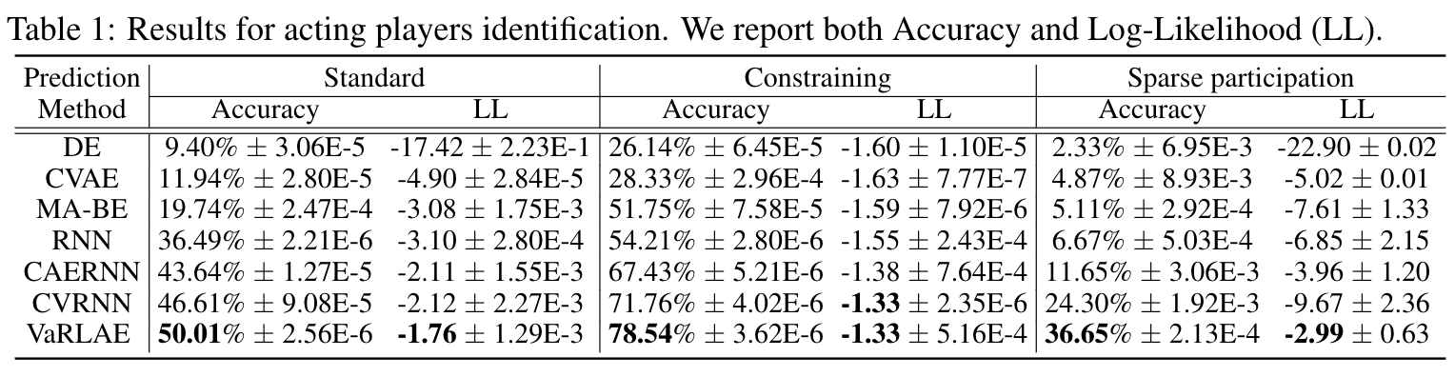
Empirical Evaluation
Generative Performance: On-Puck Player Identification
Predict which player is acting given the current match context.
Comparison method follows (ablation Design): CVRNN, CAERNN, RNN, MA-BE, CVAE, DE
Neurips 2020 Presentation
Notes:
Shrinkage Effect:
It allows information to be transferred between the observations of different players and draws closer the representations of players who share statistical similarities.
A shrinkage estimator prevents theencoder from overfitting to players with high participation, allowing our representation to generalizeto the diversity and the sparsity of context-aware player distributions.

